Slide 1


CS 6831 Designing Secure Cryptography
Tom Ristenpart

Slide 2
Real-or-random indistinguishability
Can’t distinguish from random bits under chosen-message attack
Adversary can repeatedly query Enc on same message

Slide 3
CPA definitions recap
Many ways to define confidentiality under chosen-plaintext attack (CPA) for symmetric encryption
IND-CPA is classic one
Inherited from asymmetric encryption literature
IND$ is used widely too
Generally both easier to work with and strictly stronger
IND-SIM is not as widely used
Introduced for pedagogical purposes: introduction to simulator-based defs
We’ll see that CPA is not nearly strong enough for practical use
But useful conceptual and technical building block

Slide 4
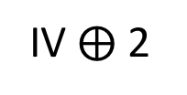
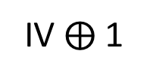
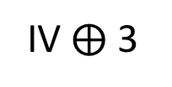
CTR mode from a block cipher
IV $⨁$ 1
IV $⨁$ 2
IV $⨁$ 3
IV is random 128 bit value
E_{K}
E_{K}
E_{K}
P1
P2
P3
M1
M2
M3
C1
C2
C3
Key generation simply picks random k-bit key

Slide 5
CTR mode variants
Stateful CTR mode
Store a counter across invocations of encryption, make sure it never repeats
Encrypted

Slide 6

Active attack example: session handling and login
GET /index.html
Set-Cookie: AnonSessID=134fds1431
POST /login.html?name=bob&pw=12345
Protocol
is HTTPS.
Elsewhere else just HTTP.
Nowadays increasingly all HTTPS
Cookie: AnonSessID=134fds1431
Set-Cookie: SessID=83431Adf
GET /account.html
Cookie: SessID=83431Adf

Slide 7
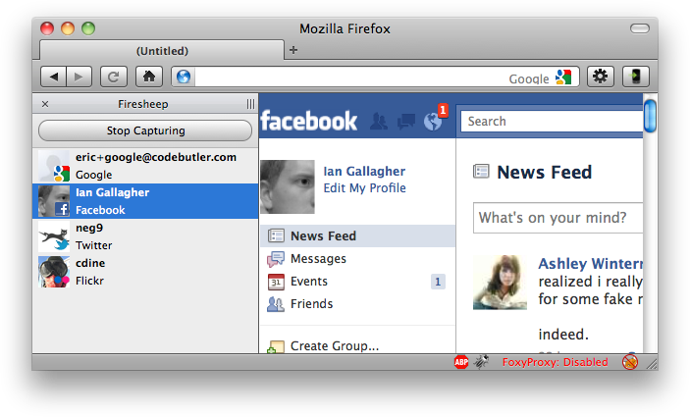
Session Hijacking
From http://codebutler.com/firesheep

Slide 8


Security problems here?
Facebook.com
POST /login.html?name=bob&pw=12345
Cookie: AnonSessID=134fds1431
Set-Cookie: SessID=83431Adf
Secret key K only known to server
GET /account.html
Cookie: SessID=83431Adf
83431Adf = CTR-Enc(K, “admin=0”)
Malicious client can simply flip a few bits to change admin=1

Slide 9
CBC mode has “malleability” issues, too
M[1]
M[2]
M[3]
IV
E_{K}
E_{K}
E_{K}
C0
C1
C2
C3
How do we change bits of M1 received by server??
M[1] ⨁ D
IV
For any D:
D_{K}
C0 ⨁ D
C1

Slide 10
Padding for CBC mode
CBC mode handles messages with length a multiple of n bits
We use padding to make it work for arbitrary length messages
Padding checks often give rise to
padding oracle attacks

Slide 11
Simple situation: pad by 1 byte
M[1]
M[2]||P
Assume that
M[1]||M[2] has length
2n-8 bits
IV
E_{K}
E_{K}
P is one byte of padding
that must equal 0x00
C0
C1
C2
C0 , C1 , C2
ok
Adversary
obtains
ciphertext
C0,C1,C2
Dec(K, C’ )
M[1]’||M[2]’||P’ = CBC-Dec(K,C’)
If P’ ≠ 0x00 then
Return error
Else
Return ok
C0, C1⨁1 , C2
error

Slide 12
Simple situation: pad by 1 byte
M[1]
M[2]||P
Assume that
M[1]||M[2] has length
2n-8 bits
IV
E_{K}
E_{K}
P is one byte of padding
that must equal 0x00
C0
C1
C2
Low byte of M1 equals i
R, C0 , C1
error
R , C0⨁1 , C1
error
Adversary
obtains
ciphertext
C = C0,C1,C2
Let R be arbitrary
n bits
Dec(K, C’ )
M[1]’||M[2]’||P’ = CBC-Dec(K,C’)
If P’ ≠ 0x00 then
Return error
Else
Return ok
R , C0⨁2 , C1
error
…
R , C0⨁i , C1
ok

Slide 13
PKCS #7 Padding
PKCS#7-Pad(M) = M || P || … || P
P repetitions of byte encoding number of bytes padded
01
02 02
03 03 03
04 04 04 04
…
FF FF FF FF … FF
Possible paddings:
For block length of 16 bytes, never need more than 16 bytes
of padding (10 10 … 10)
Notes:
Examples on board

Slide 14
Decryption (assuming at most one block of padding)
Dec( K, C )
M[1] || … || M[m] = CBC-Dec(K,C)
P = RemoveLastByte(M[m])
while i < int(P):
P’ = RemoveLastByte(M[m])
If P’ != P then Return error
i++
Return ok
“ok” / “error” stand-ins for some other behavior:
Passing data to application layer (web server)
Returning other error code (if padding fails)

Slide 15
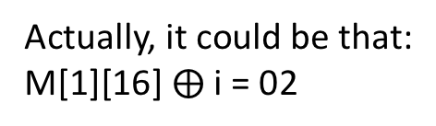
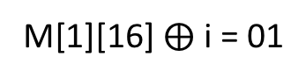
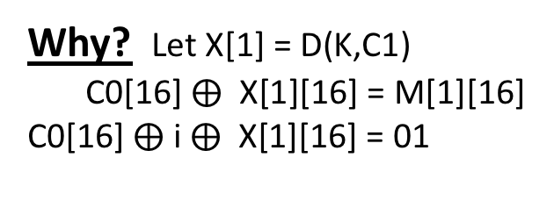
PKCS #7 padding oracles
Low byte of M[1] most likely equals i ⨁ 01
R, C0 , C1
error
R , C0⨁1 , C1
error
Dec( K, C )
M[1] || … || M[m] = CBC-Dec(K,C)
P = RemoveLastByte(M[m])
while i < int(P):
P’ = RemoveLastByte(M[m])
If P’ != P then Return error
i++
Return ok
Adversary
obtains
ciphertext
C = C0,C1,C2
Let R be arbitrary
n bits
R , C0⨁2 , C1
error
…
R , C0⨁i , C1
ok
Why? Let X[1] = D(K,C1)
C0[16] $⨁$ X[1][16] = M[1][16]
C0[16] $⨁$ i $⨁$ X[1][16] = 01
Actually, it could be that:
M[1][16] $⨁$ i = 02
M[1][16] $⨁$ i = 01
Implies that M[1][15] = 02
We can rule out with an additional query

Slide 16
PKCS #7 padding oracles
Second lowest byte of M[1] equals i ⨁ 02
R, C0 , C1
error
R , C0⨁1||j , C1
error
Dec( K, C )
M[1] || … || M[m] = CBC-Dec(K,C)
P = RemoveLastByte(M[m])
while i < int(P):
P’ = RemoveLastByte(M[m])
If P’ != P then Return error
i++
Return ok
Adversary
obtains
ciphertext
C = C0,C1,C2
Let R be arbitrary
n bits
R , C0⨁2||j , C1
error
…
R , C0⨁i||j , C1
ok
Set j = M[1][16] ⨁ 01 ⨁ 02

Slide 17
Can we change decryption implementation?
Dec( K, C )
M[1] || … || M[m] = CBC-Dec(K,C)
P = RemoveLastByte(M[m])
while i < int(P):
P’ = RemoveLastByte(M[m])
If P’ != P then Return error
i++
Return ok
“ok” / “error” stand-ins for some other behavior:
Passing data to application layer (web server)
Returning other error code (if padding fails)

Slide 18
Chosen ciphertext attacks against CBC
Attack | Description | Year
Vaudenay | 10’s of chosen ciphertexts, recovers message bits from a ciphertext. Called “padding oracle attack” | 2001
Canvel et al. | Shows how to use Vaudenay’s ideas against TLS | 2003
Degabriele, Paterson | Breaks IPsec encryption-only mode | 2006
Albrecht et al. | Plaintext recovery against SSH | 2009
Duong, Rizzo | Breaking ASP.net encryption | 2011
Jager, Somorovsky | XML encryption standard | 2011
Duong, Rizzo | “Beast” attacks against TLS | 2011
AlFardan, Paterson | Attack against DTLS | 2012
AlFardan, Paterson | Lucky 13 attack against DTLS and TLS | 2013
Albrecht, Paterson | Lucky microseconds against Amazon’s s2n library | 2016

Slide 19
Modeling active attacks
Encryption oracle
Decryption oracle
Attacker can obtain ciphertexts, send manipulated ones
Need an encryption oracle
Need a decryption oracle
Models man-in-the-middle (MITM) attacks, for example

Slide 20

Authenticated encryption security
Attacker can’t distinguish between: encryption & decryption versus random bits & bot oracle
Notes:
Describe a couple example of how to achieve it

Slide 21

ROR + CTXT <=> ROR-CCA
We can “decompose” ROR-CCA security into two separate notions
ROR security (which we saw earlier)
Ciphertext integrity (CTXT)
Adversary, given encryption oracle, can’t construct any new ciphertext that decrypts to some message
Leave it to notes:
Show ROR-CCA implied by ROR + CTXT
Show ROR implied by ROR-CCA
Show CTXT implied by ROR-CCA

Slide 22
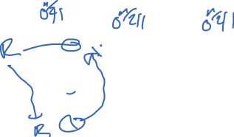
Towards ROR-CCA: OCB
Recall our OCB CPA-core scheme using tweakable block cipher
(assume only allow |M| = 3n):
M1
M2
M3
N is
random
IV/nonce
C0 = N
C1
C2
C3
What is decryption algorithm?
Reject if |C| != 4n
Decrypt via inverse of tweakable blockcipher
Return resulting M1 || M2 || M3

Slide 23
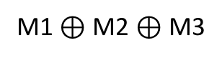
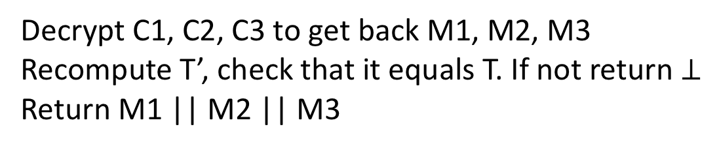
Towards ROR-CCA: OCB
Recall our OCB CPA-core scheme using tweakable block cipher
(assume only allow |M| = 3n):
M1
M2
M3
M1 $⊕$ M2 $⊕$ M3
N is
random
IV/nonce
C0 = N
C1
C2
C3
T
What is decryption algorithm?
Decrypt C1, C2, C3 to get back M1, M2, M3
Recompute T’, check that it equals T. If not return $⊥$
Return M1 || M2 || M3

Slide 24
Proving CTXT requires strong tweakable PRPs
Previous notions for PRP only dealt with CPA attacks
Need TBC’s that resist CCA attacks as well

Slide 25
Proving CTXT requires strong tweakable PRPs
Previous notions for PRP only dealt with CPA attacks
Need TBC’s that resist CCA attacks as well
Luby-Rackoff 3 round not SPRP secure or STPRP secure
Need 4 rounds of Feistel
XE construction not secure either

Slide 26
Proving CTXT requires strong tweakable PRPs
Previous notions for PRP only dealt with CPA attacks
Need TBC’s that resist CCA attacks as well
2^{i}
M
T
Important caveat:
Don’t allow tweaking
by i = 0, otherwise attack

Slide 27
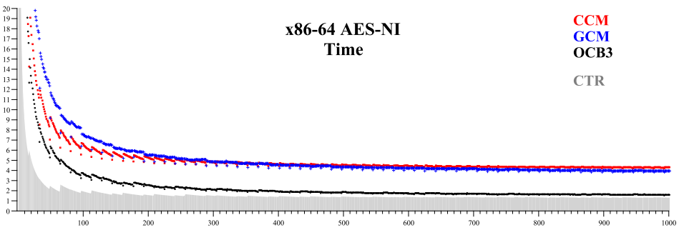
Recap of OCB
We only showed simplified version of algorithm.
Handling non-multiple-of-n messages, choosing z
OCB fastest “single pass” AE scheme in most contexts
Up next: message authentication, generic composition
From [Krovetz, Rogaway 2011]:
Cycles/byte
Message length (bytes)

Slide 29
Next class: authenticated encryption
How do we build symmetric encryption that resists active attacks?
Authenticated encryption
Confidentiality
Integrity

